Slide 1
Escalation Workflow Optimization Using Root Cause Analysis
Contact Center Environment
By : Akshat Shrivas | Business Analyst

Slide 2
Escalation Problem Summary
Escalation rates increased from 4.2% → 11.8% over 7 weeks.
Identified issues:
• Manual routing and delayed approvals
• Customer repeating information multiple times
• No clear triage or prioritization rules

Slide 3
Root Cause Analysis Summary
Primary contributing factors:
• Multiple handoffs and approval layers
• Outdated knowledge content leading to inconsistent responses
• Lack of automated routing based on case type
Methods applied:
• Fishbone Diagram
• 5 Whys

Slide 4
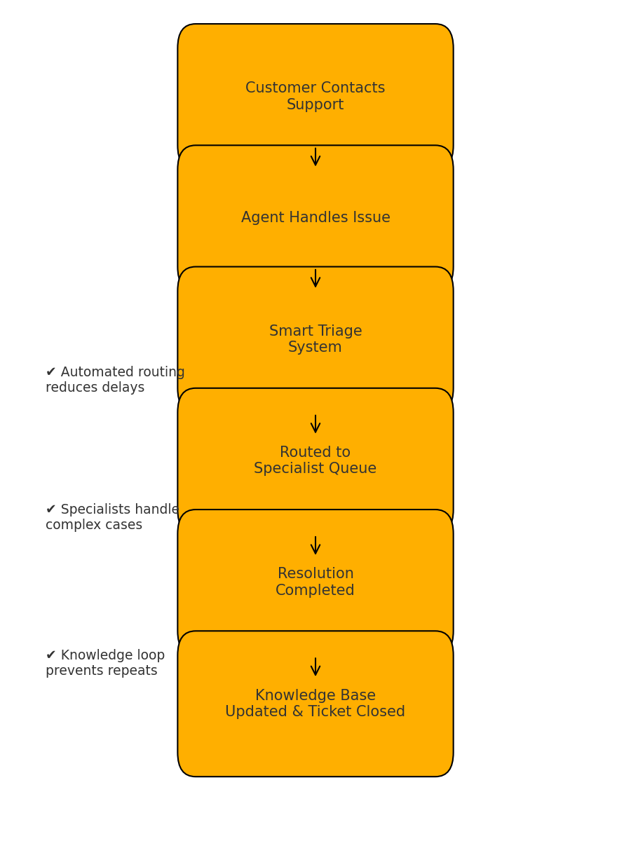
Current Workflow (AS-IS)
Existing escalation workflow relies heavily on manual routing and supervisor intervention.
Key pain points:
• Slow routing
• Bottlenecks at supervisor/manager level
• No automation or logic-based assignment

Slide 5
Future Workflow (TO-BE)
Redesigned workflow introduces automation and logic-driven routing to reduce dependency on manual escalation.
Key improvements:
• Smart triage automation
• Specialist routing based on issue type
• Knowledge base update trigger loop

Slide 6
Expected KPI Impact
Projected improvements:
• Escalation Rate: 11.8% → <5%
• Resolution Time: 9.1 min → ~7.2 min
• First Touch Resolution: 61% → 75–80%
• CSAT: 3.6 → ≥ 4.2

Slide 7
Conclusion
The new workflow shifts from reactive escalation management
to proactive escalation prevention.
Outcome:
• Faster handling
• Reduced friction
• Improved customer experience
• More efficient routing and decision-making

